Slide 1
Seis 635: Software analysis and design Hotel Checking system
Biniam G Haile Darius O. Nyaundi Elvis A. Ndenge Patrice A. Yemmene Eyad Shes

Slide 2
introduction
This is the final sprint for the third team project
We envisioned, designed and developed a Hotel Checking system (HCS)
Hotel employees may use this system to facilitate the check-in process of their guests, with membership-based priority.
This system is flexible to support varying business rules, a few user interface mechanisms (Front Desk, Housekeeping, and Reservation Services) and integration with third party systems
We followed the Unified Process

Slide 3
Summary of system features
System designed for hotel operations.
Guests will be checked in by the FrontDesk (worker) who will coordinate with housekeeping (worker) to insure the rooms are cleaned and ready for occupancy through the system.
RoomService will check minibar in room and enter minibar status in system as well.

Slide 4
Summary of system features
Once rooms are cleaned and minibar restocked, FrontDesk will check each Guest club-status (gold, silver or none- member) and assign rooms by priority.
If the room is not clean the Guest will have to wait based on priority status. There will be interactions between the <<Patrons>> <<FrontDesk>> <<RoomService>>and <<housekeeping>>.
There is also an interface allowing users <<Patron>> <<FrontDesk>> <<RoomService>>and <<housekeeping>> to interact with each other

Slide 5
Central Use case 1
HCIR: Patron Check In Room
Scope: Hotel reservations: Check-In Patron.
Level: User Goal
Primary Actor: FrontDest
Preconditions:
FrontDesk has logged in to the System. Patron must have confirmation number after previously reserving online. System has Patron’s reservation already stored in with name and confirmation number. Rooms must be clean and minibar must be restocked. Also the Patron must have priority status.
Success Guarantee (Post Condition):
Patron has a reservation already in the system and a confirmation number. Room is Vacant, clean and Minibar is restocked. Priority by membership is honored.

Slide 6
Central Use case 2
Success Guarantee (Post Condition):
Patron is out of room and checked out with front desk. MiniBar is restocked and rooms are vacant and clean. All MiniBar restocking fees are paid.
Main Success Scenario (Basic Flow):
Patron leaves the room.
HouseKeeping checks room occupancy.
HouseKeeping marks the room as Vacant Dirty (VD) in system once patron leaves.
InRoomDinning checks MiniBar in Room.
InRoomDinning marks MiniBar Not Restocked (MBNR) in System once Patron leaves Room.
Extensions (Alternative Flow):
Patron does not leave the Room so that Room is still Occupied (OC).
UCOR: Patron Check Out Room
Scope: Hotel reservations: Check-Out Patron.
Level: User Goal
Primary Actor: Patron
Preconditions:
HouseKeeping Checks if Room is occupied. FrontDesk Logs into system to check if room is occupied. Patron must leave room or will be charged for another night.

Slide 7
Controller (Database_manager)
What first object beyond the UI layer first receives and coordinates.
A non-user interface object responsible for receiving or handling a system event.

Slide 8
INFORMATION EXPERT (room, member)
Intuitively assigning responsibilities to classes.
A class has (most of) the expertise needed to complete a task.
That class is associated with others can provide any missing information.

Slide 9
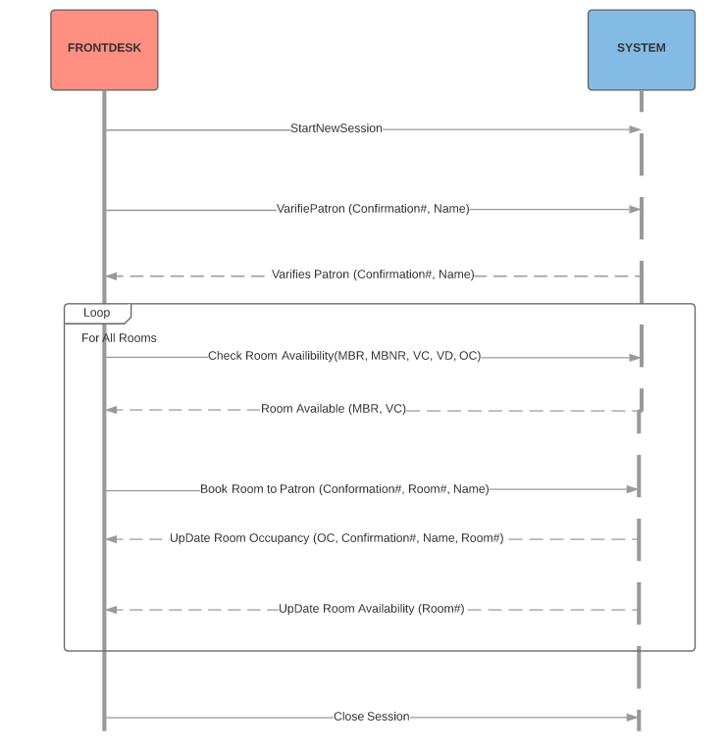
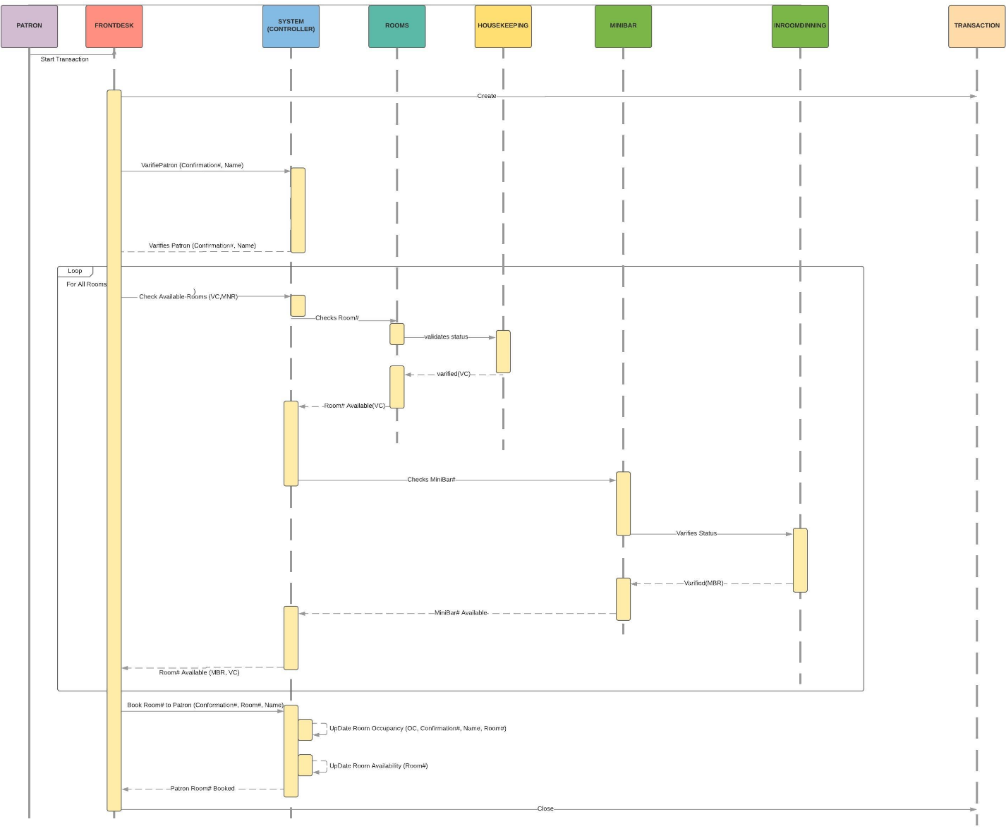
System sequence diagram (before)

Slide 10
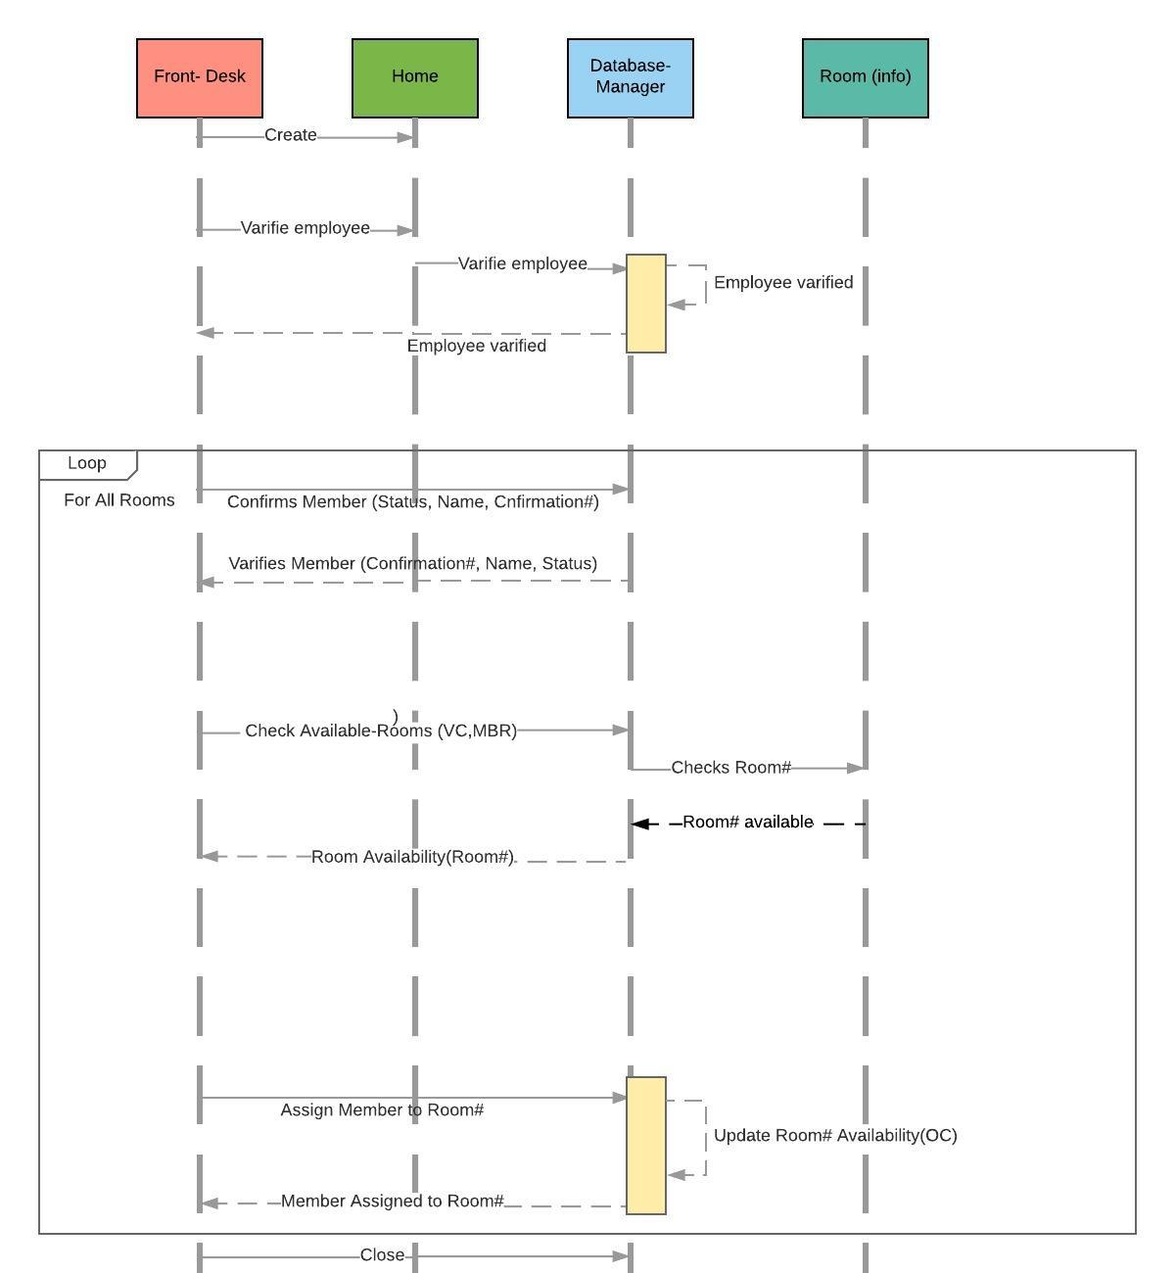
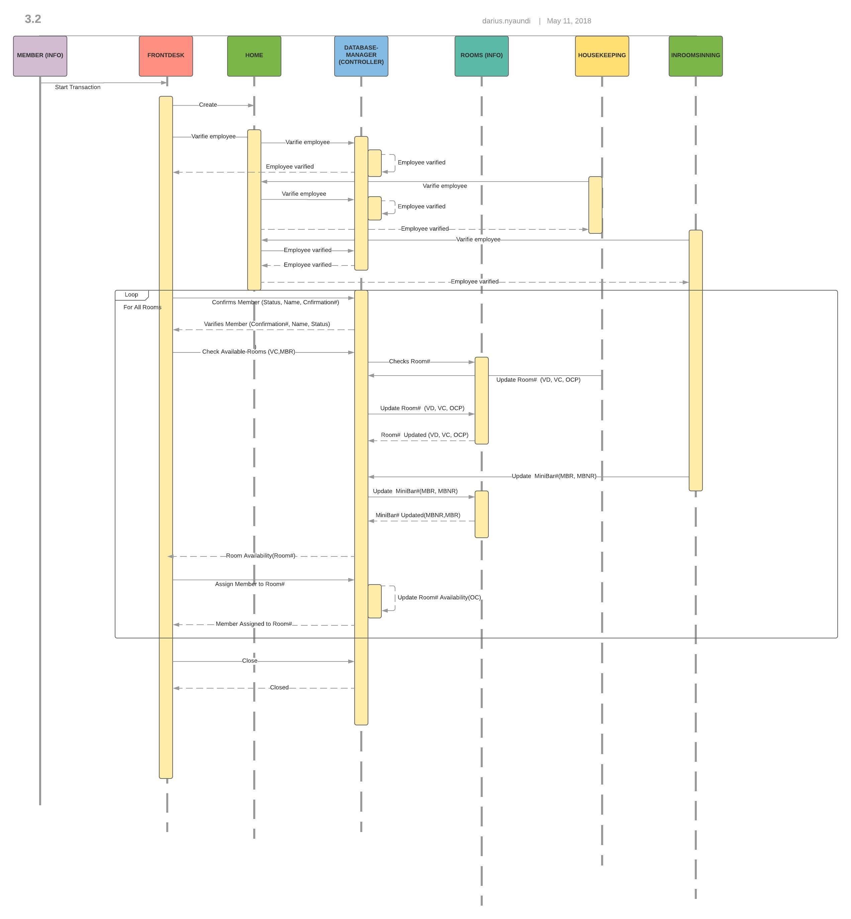
System sequence diagram

Slide 11
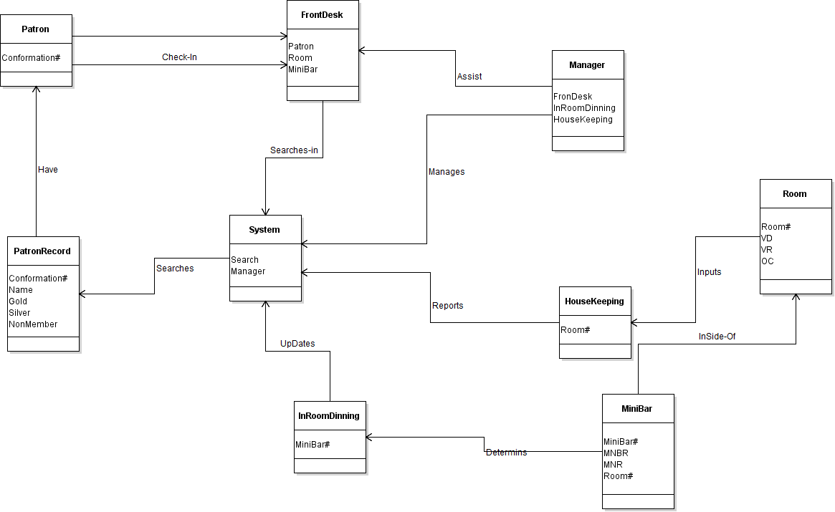
Before (docd)

Slide 12
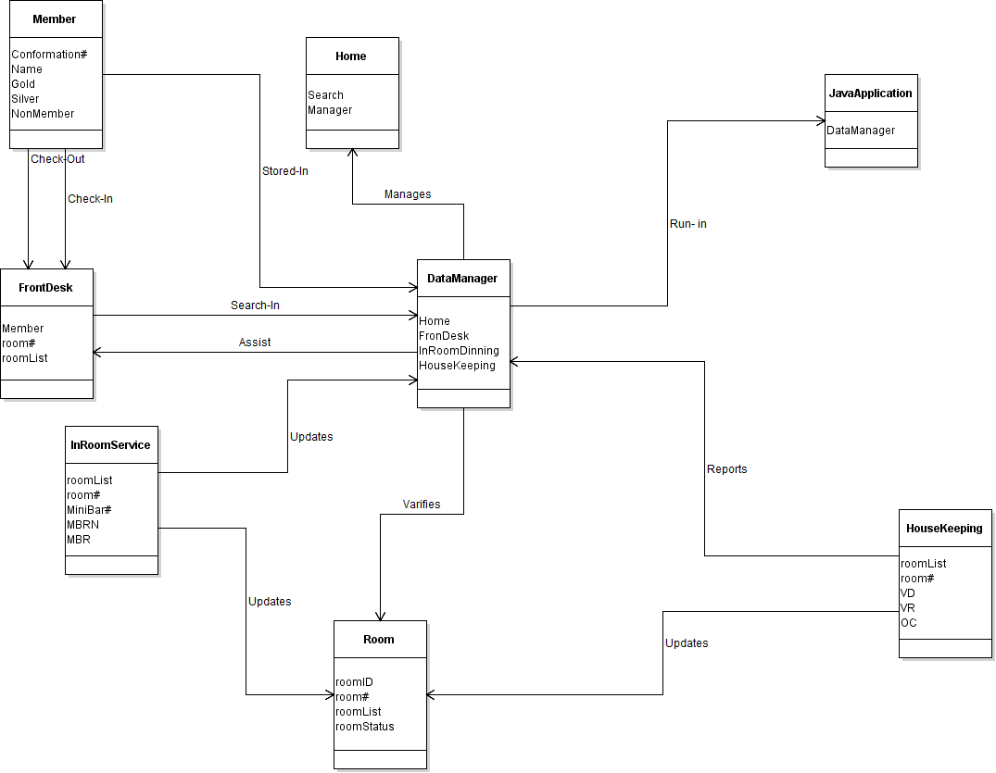
Domain class diagram (After)

Slide 13
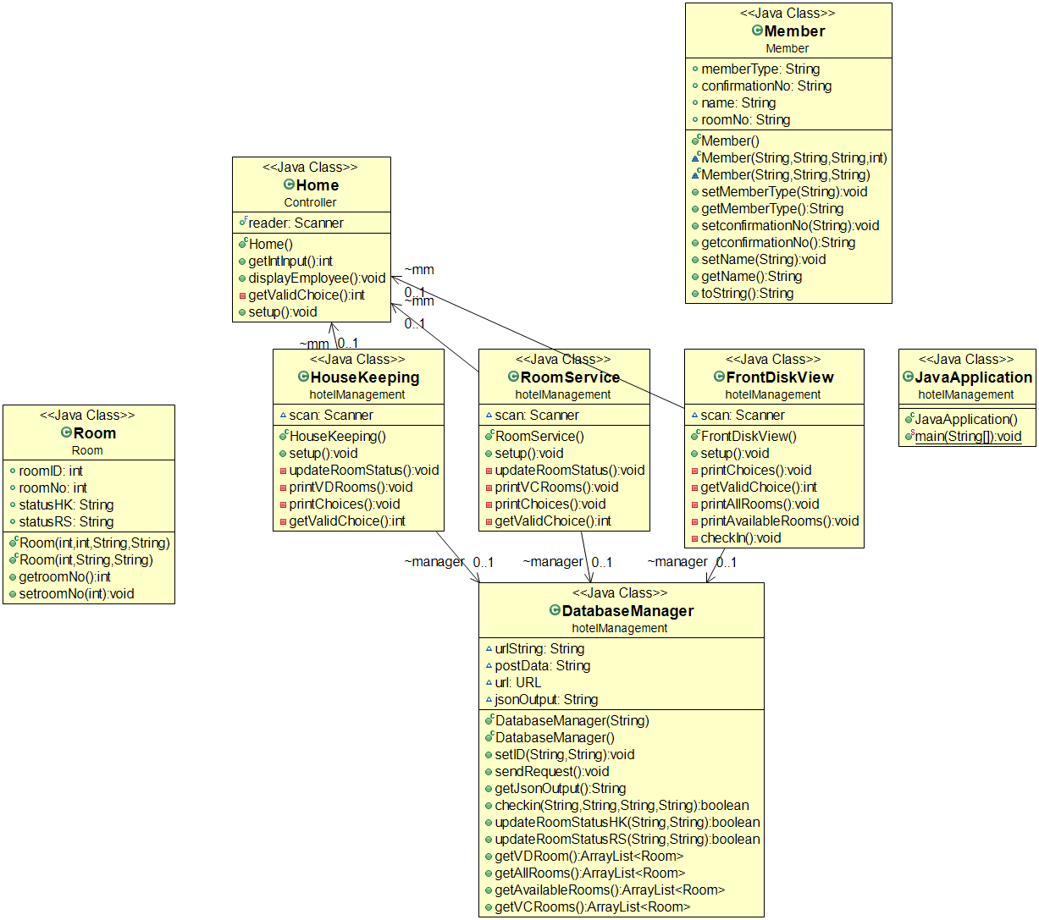
Reverse engineered Class Diagram

Slide 14
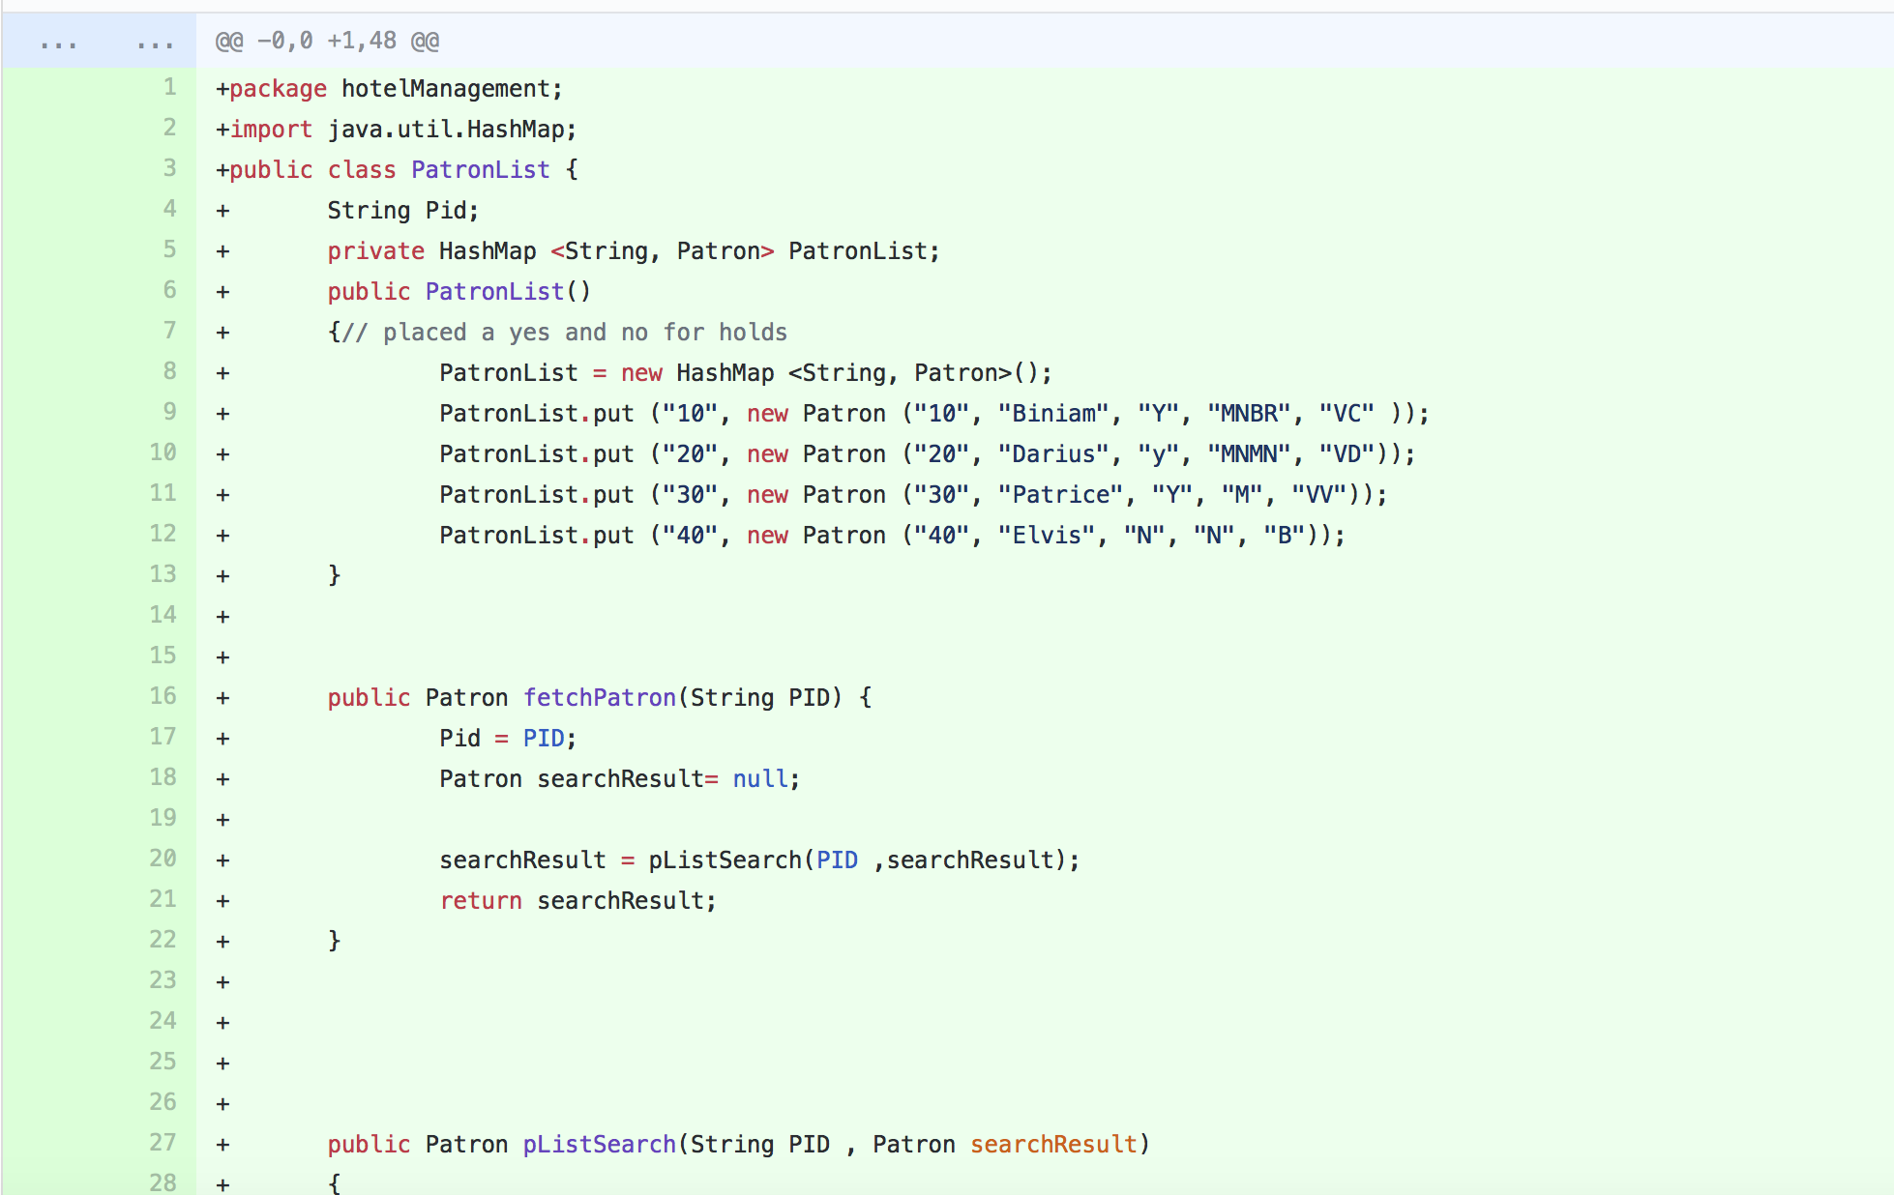
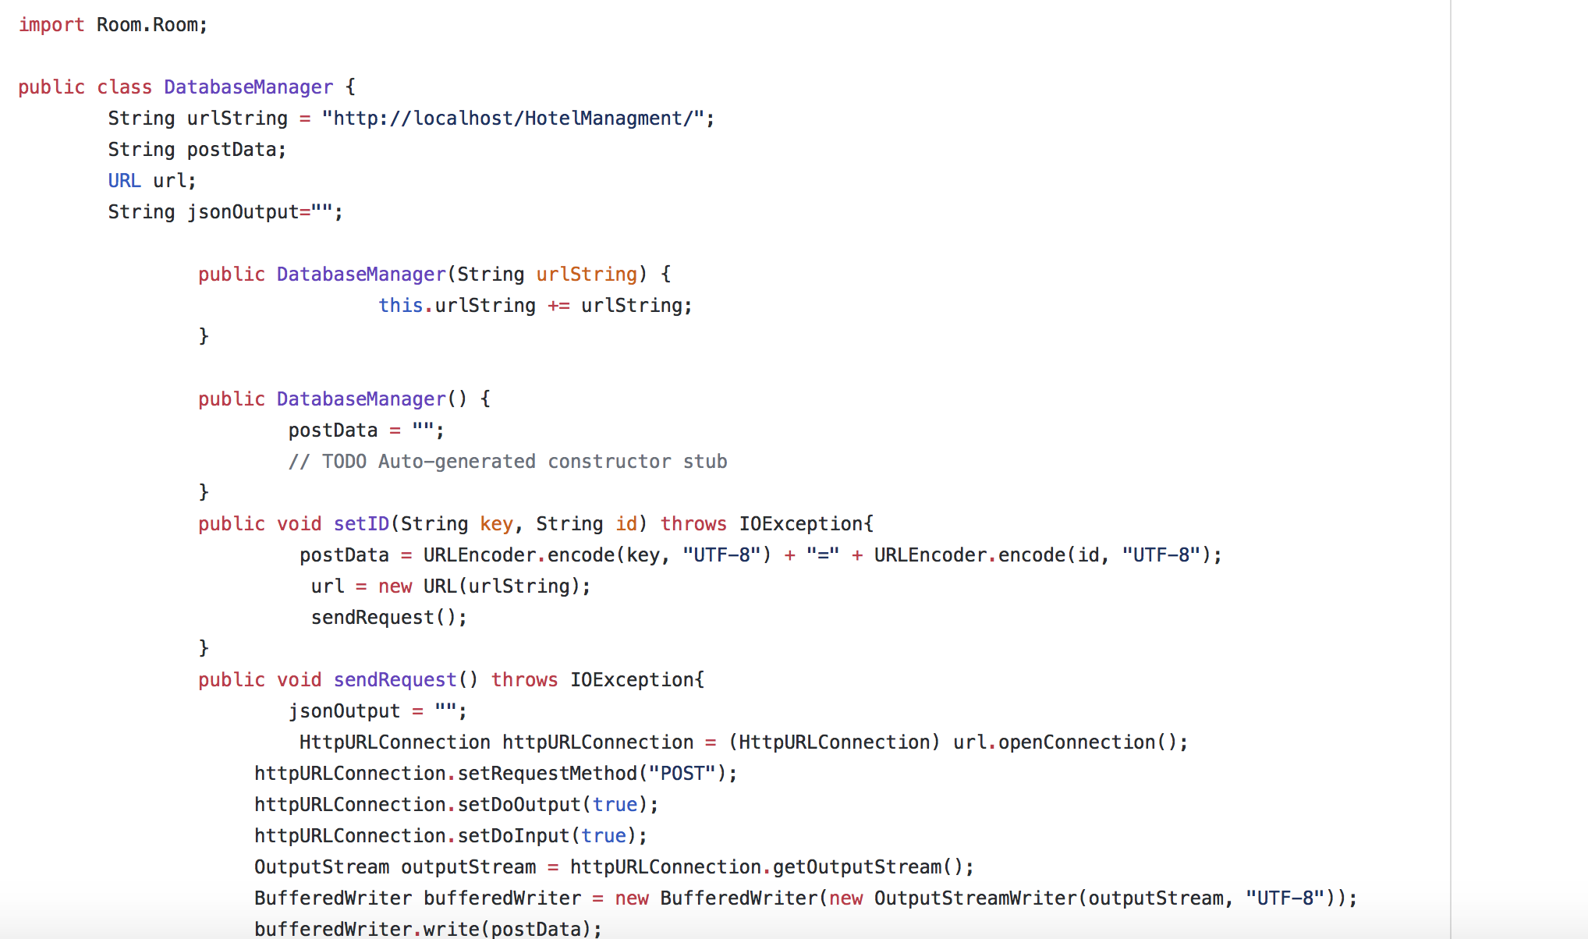
HASH CODE/DATABASE
Before
After

Slide 15
Code smell
Renamed methods
Renamed variables
Refactored code

Slide 16
CODE Demonstration

Slide 17
Problem solved
Access to Database
Push it to the cloud using Amazon Web Services (AWS)

Slide 18
Running the Application
Hotel CheckIn System SuD uses mySql database called HotelManagementDB and this database has four tables:
Member
Room
RoomStatusHK
RoomStatusRS

Slide 19
Running the Application
Step 1: Place the URL “http://35.173.198.1/phpmyadmin” CMSDB (CreateDBScript) in to your browser.
Step 2: Enter a UserName and a new PassWord of database admin.
Step 3: Run JavaApplication.
Step 4: Home screen Select option 1 Front Desk, 2 House Keeping, 3 In Room Service -1Quit Application
Step 5: Select option 1 Front Desk, and employee at front desk will be able to Option 1 Print rooms report Option 2 Print available rooms and Option 3 for Check-in Option -1 to go back to the Home Screen

Slide 20
Running the Application … continued
Step 5: Select option 3 for Check-in Option, the user asked to enter the confirmation number followed by Patron’s name, Membership Type [Gold, Silver and Non Member] next the user will be prompted to enter the room number (If the room is not vacant the system will notify the user that the room is not vacant)
Step 6: If the user selects option 2 from the Home Scree which is House Keeping, the following options will be available. The user will be able to 1 Print Room List and 2 Update Room Status and -1 to return to Home Screen.
Step 7: If the user selects option 3 from the Home Scree which is In Room Service, the following options will be available.

Slide 21
Thank you
And congratulations to those graduating this semester

